Slide 1
Word Embeddings in NLP
Jamal Shah

Slide 2
Introduction
Most machine learning algorithms don’t understand text data but numerical data. So it is necessary to represent the text data in numerical form
Word embeddings are an efficient way of representing words in the form of vectors.
Word embeddings provide similar vector representations for words with similar meanings.

Slide 3
Introduction
Word Embedding is an approach for representing words in vector form. It provides similar vector representations for words that have similar meanings. It helps the model to capture the linguistic meaning of the word.
For example, consider 4 words: cricket, football, mountain, and sea. Among these words – Cricket and football are related, and sea and mountain are related, so similar vector representations are given to related words. The Figure shows cricket and football are placed together, and mountain and sea are placed together. This can help learn the semantic meaning of the word.

Slide 4
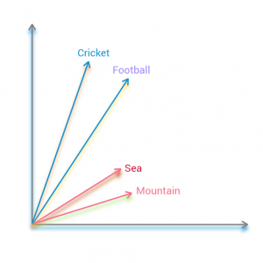
Introduction
Word Embedding is an approach for representing words in vector form. It provides similar vector representations for words that have similar meanings. It helps the model to capture the linguistic meaning of the word.
For example, consider 4 words: cricket, football, mountain, and sea. Among these words – Cricket and football are related, and sea and mountain are related, so similar vector representations are given to related words. The Figure shows cricket and football are placed together, and mountain and sea are placed together. This can help learn the semantic meaning of the word.

Slide 5
FastText
FastText provides embeddings for character n-grams, representing words as the average of these embeddings. It is an extension of the word2vec model.
Word2Vec model provides embedding to the words, whereas fastText provides embeddings to the character n-grams. Like the word2vec model, fastText uses CBOW and Skip-gram to compute the vectors.
FastText can also handle out-of-vocabulary words, i.e., the fast text can find the word embeddings that are not present at the time of training.

Slide 6
Working of FastText
Consider the word “equal” and n = 3, then the word will be represented by character n-grams:
< eq, equ, qua, ual, al > and < equal >
So, the word embedding for the word ‘equal’ can be given as the sum of all vector representations of all of its character n-gram and the word itself.

Slide 7
Continuous Bag Of Words (CBOW)
In the Continuous Bag Of Words (CBOW), we take the context of the target word as input and predict the word that occurs in the context.
For example, in the sentence “ I want to learn FastText.” In this sentence, the words “I,” “want,” “to,” and “FastText” are given as input, and the model predicts “learn” as output.
All the input and output data are in the same dimension and have one-hot encoding. It uses a neural network for training. The neural network has an input layer, a hidden layer, and an output layer.

Slide 8
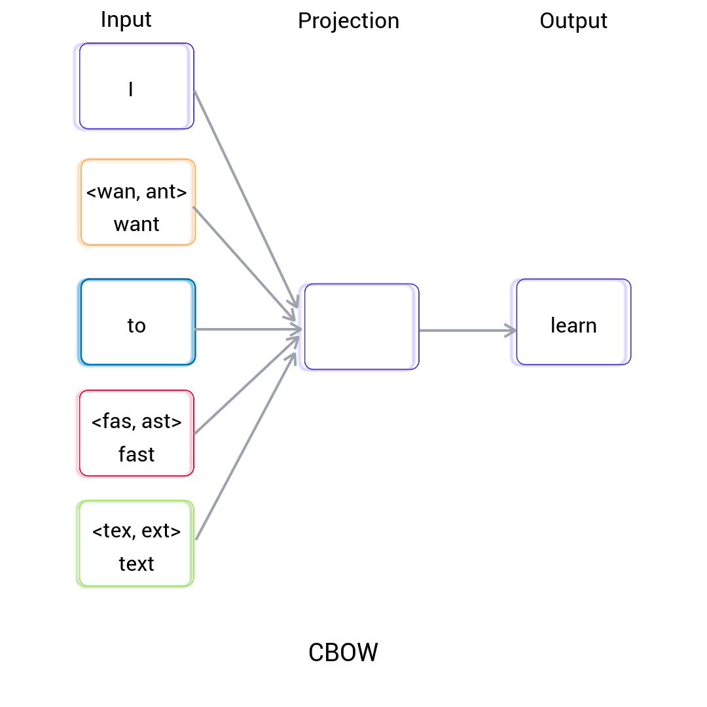
Continuous Bag Of Words (CBOW)

Slide 9
Skip-gram
Skip-gram works like CBOW, but the input is the target word, and the model predicts the context of the given the word. It also uses neural networks for training.

Slide 10
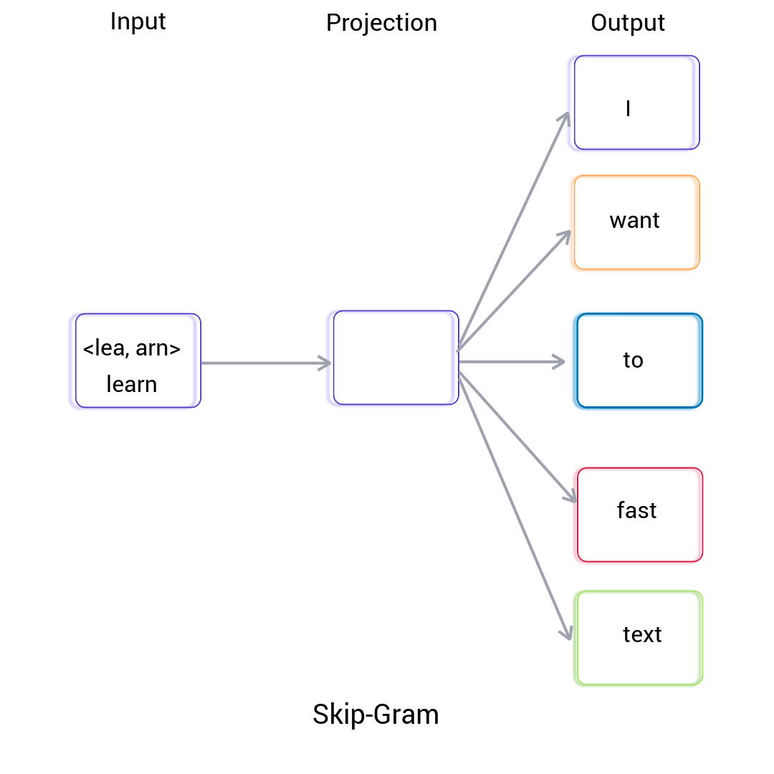
Skip-gram

